Slide 1
Working with Workers: Talking About Workplace Safety and Health
A training module for Community Health Workers
Developed by Barry Commoner Center for Health and the Environment,Queens College and Make the Road NY

Slide 2
Work-Related injuries, illnesses and deaths are too common and are preventable
2.9 million work related injuries and illnesses in private sector in 2016
  That is 3 out of every 100 workers
5,190 fatal work injuries in 2016
  Every 100 minutes a worker dies from a fatal injury on the job.
  3 workers will die during our 4 hour class today
Notes:
In 1913, Bureau of Labor Statistics documented approximately 23,000 industrial deaths among a workforce of 38 million, equivalent to 61 deaths per 100,000 workers
In 1970, when OSHA was created, the rate was 18/100,000 workers
Historically a huge improvement, but still too many preventable deaths and injuries. Current statistics represent almost 12 worker deaths each day. Globally health and safety issues are also a huge concern. According to WHO and ILO estimates for the year 2000, there are 2 million work-related deaths per year.
Three key points:
Work-related fatalities from injuries – these statistics are just the “tip of the iceberg”
We’re doing much better than historically – 1913 (61/100,000 workers) compared to 1970 when OSHA was enacted to ensure worker protection at a rate of 18/100,000 full-time workers – not shown) until 2013, most recent figures, with rate of 3.3. But still too many deaths.
Photos illustrate the quote, “Statistics are human beings with the tears wiped away” – Quoted by Dr. Irving Selikoff in video. Range of workers affected is shown by photos: 23 yr old Sherry Sangji, a laboratory researcher at UCLA who died when a chemical reaction severely burned her, and a laborer who died when an unshored trench collapsed (photo from Cincinnati, 2002, David Michaels)
BLS: rate per 100,000 full-time equivalent workers
---------------------------------------
Sources:
Source of 2013 BLS data: http://www.bls.gov/iif/oshwc/cfoi/cfoi_revised13.pdf (April 2015, Revisions to the 2013 Census of Fatal Occupational Injuries (CFOI) counts)
Source of 1913 and 1970 data: David Michaels, Assistant Secretary of Labor for OSHA, 2011

Slide 3
Motivational Interviewing
Motivational Interviewing is one way of speaking and working with clients that can:
Help you create a stronger relationship with the client
Focus the client on identifying solutions and actions they feel capable of doing

Slide 4
Motivational Interviewing
The 4 main characteristics of MI are:
1. Open-Ended Questioning
2. Affirmation
3. Reflective Listening
4. Summary

Slide 5
Open Ended Questions
Open-ended questions require more than just a “yes/no” answer.
  The information the client provides improves the conversation for both the worker and the CHW.
Verbal probing is a technique that can help with moments of resistance and/or hesitation or if additional information is needed. Some strategies include asking the client:
  What he or she was thinking that made them hesitate
  How or why they remember a particular situation or experience.
  How they felt about something that happened, or what made them feel that way

Slide 6
Open-ended Questions and Probes
Example
Question | Open or Closed? | A probe would likely be useful
Do you work in construction? | Closed | What do you work as?
How was work today? | Open/Closed | Can you tell me about something that happened today that you enjoyed?
What did you do today at work? | Open/Closed | What are the different steps you have to do to complete that task
What potential risks have you noticed at work? | Open | Have any of your co-workers noticed anything?

Slide 7
Affirmation
Comments and gestures that recognize positive behaviors and successes. Focusing on the worker’s strengths, efforts, patience and perseverance brings about confidence and self-efficacy.
  Acknowledging small successes
    “It's great that you were able to ask your boss that question”
  Complementing for making an effort
    “Thank you for coming in today and telling me this”
  Stating appreciation or understanding.
    “Your initiative shows the respect and care you have for your coworkers”

Slide 8
Reflective and Active Listening
Reflection throughout the dialogue is a key part of active listening. The CHW makes sure that he or she has understood the client.
Strategies:
Repeat what was said in the clients’ own words
Paraphrase what the client said using the CHW’s own words
Interpret the clients’ meaning or intent using the CHW’s own words

Slide 9
Example Reflective and Active Listening
Repetition
Paraphrasing
Interpretation
“You don’t think this will happen because you think your boss doesn’t care about how hard you work.”
"You don’t think your boss sympathizes with the number of hours you put in.”
“If I understand you correctly, it sounds like your boss has not expressed a concern about the number of hours you put in and you think that it might be hard to change his attitude.”

Slide 10
Summarizing
A summary statement gives the client the opportunity to hear his/her own thoughts out loud, to verify or tweak them, and to be reminded of his/her own statement of problems, solutions, and desire to change.
It's helpful to end summary statements with an open question such as "What else?" to invite the worker to continue the narrative.

Slide 11
Examples of Summarizing
The CHW repeats what the client says with short and concise key points.
“This is what I’ve heard you say up until now… What am I missing?”
“Let me make sure I understand you completely. What I’ve been hearing you say is… Is that right?”
The worker may begin to offer statements indicating the desire to change:
"I don't want to set the wrong example for my kids."
“I want my kids to grow up being able to see both their parents.”
“We work so hard, we have to be given more breaks.”
"My worksite needs to be safer if we want to prevent injuries."

Slide 12
What is a Job Hazard?
Anything at work that can hurt you, either physically or mentally

Slide 13
Hazard Mapping 1
CHEMICAL HAZARDS (Green)
They exist as solids, liquids or gases.
Open containers
Liquid chemicals
Metal dust
Fumes
SAFETY HAZARDS (light blue)
Anything at work that can injure your body.
Being hit, cut or amputated
Burned, shocked or electrocuted
A condition causing slip, trip or fall
PHYSICAL HAZARDS (Dark Blue)
Anything that can put you in contact with
Constant loud noise
Vibration of tools or equipment
Inadequate lighting
too hot or too cold temperatures
CHEMICAL HAZARDS (Green)
SAFETY HAZARDS (Light blue)
PHYSICAL HAZARDS (Dark Blue)

Slide 14
Hazard Mapping 2
A work environment that promotes stress, harassment, and violence
Not enough staff
Too much work or pressure to do it fast
High production quotas
Environments where employees work alone
ERGONOMIC HAZARDS (Orange)
Tasks that create temporary or permanent pain in your muscles, joints, tendons or nerves.
Repetitive movements
Awkward postures
Heavy lifting
BIOLOGIC HAZARDS (Red)
Tiny living organisms that can make you sick or develop a disease.
Contact with blood or an infectious disease
Allergens, TB, Hepatitis
PSYCHOSOCIAL (Yellow)
ERGONOMIC HAZARDS (Red)
BIOLOGIC HAZARDS (Orange or write in)

Slide 15
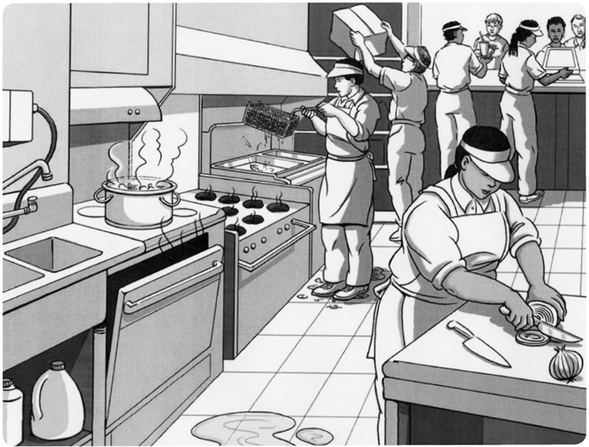
Source: Developed by the Labor Occupational Health Program at UC Berkeley. This image can be used for educational purposes only (with permission)

Slide 16
Food Services:
Examples of Job Hazards
  Safety
    Injury from sharp objects (knives)
    Fire/burns
    Trips/Slips/Falls
  Physical
    Heat conditions
    Cold conditions
  Biological
    Bacteria (handling raw meat, unsanitary conditions)
  Chemical
    Cleaning products (e.g. bleach)
  Biomechanical/Ergonomic
    Heavy lifting (e.g. heavy bags or boxes)
    Awkward postures (e.g. dish washing)
    Repetitive movements (e.g. chopping meat or vegetables)
  Psychosocial
    Stress (no time for breaks)
    Violence, harassment

Slide 17
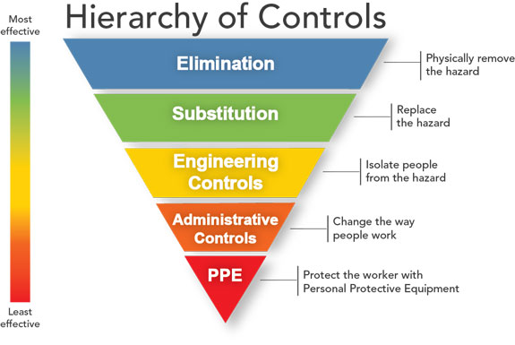
Hierarchy of Controls
Notes:
Hierarchy of controls from least effective (bottom of hierarchy) to most effective:
Personal protective equipment includes gloves, clothing respirators, to protect from chemical exposure; hearing protection to minimize hearing loss, etc. Note: These controls do not eliminate the hazard in the workplace; they just put a barrier between the worker and the hazard. This represents a “weak fence” that can break easily if the proper respirators or training to use them are not provided.
Administrative controls include training, rotating workers, adequate staffing, sufficient rest periods, training in the language understood by workers.
Engineering controls include enclosing harmful machinery, re-designing equipment, installing appropriate ventilation systems, etc. - See example in next slide.
Isolating, substituting and eliminating the hazard entirely are important measures that are even more effective and demonstrate employer willingness to institute an effective H&S program versus relying solely on workers to change their behavior.
Note: Ask students if anyone they interviewed mentioned that they received training about hazards, worked in a lab or other job with a ventilation system, or was provided protective equipment.

Slide 18
Is there a law for workplace safety and health?
The Occupational Safety and Health Act (OSH Act) became a law in 1971. The OSH Act was created to promote workplace safety and health rights for workers.
1) The General Duty Clause 5 (a) (1)
(a) Each employer --
(1) shall furnish to each of his employees employment and a place of employment which are free from recognized hazards that are causing or are likely to cause death or serious physical harm to his employees;

Slide 19
Occupational Safety and Health Administration
The OSH Act also created a federal agency, the Occupational Safety and Health Administration (OSHA).
The agency works to:
Develop rules about workplace safety
Enforce those rules through inspecting workplaces
Track workplace accidents
Train workers and employers on workplace health and safety

Slide 20
The employer is responsible to ensure a healthy and safe work environment
Make sure workers have and use safe tools and equipment and properly maintain this equipment.
Use posters, labels or signs to warn workers of potential hazards.
Establish or update operating procedures, and communicate them so that workers follow safety and health requirements.

Slide 21
OSHA employer requirements (cont)
Post, at a prominent location within the workplace, the OSHA poster informing workers of their rights and responsibilities.

Slide 22
Employer responsibility for training
The employer must train the worker to recognize, abate (minimize), and prevent safety and health hazards in their workplaces.
This must be done when you start a job, and when new equipment or chemicals are provided to perform your job.
The employer must explain hazards of chemicals used and how they can affect one’s health.

Slide 23
Employer responsibility for medical screening and recording injuries and illnesses
Provide medical examinations and training when required by OSHA standards.
  Such as blood lead testing or hearing tests when exposures are above a threshold
Provide access to employee medical and exposure records
Provide information on the injuries and illnesses that have happened to co-workers in the workplace (which is registered in the OSHA 300 log)

Slide 24
What should a worker do if there are hazards?
First, ask the employer to correct the unsafe working conditions (in writing and pictures if necessary)
    Employer must follow the hierarchy of controls in correcting the hazard
If ignored, workers can file a complaint with OSHA
    Can be done anonymously.
If an inspection happens, workers can participate in OSHA investigations and get information
If an accident or illness occurs, report it to your employer.

Slide 25
For Imminent Danger Call OSHA Immediately
  Workers should call OSHA immediately (1-800-321-OSHA) to report imminent dangers.
  To count as an “imminent” danger, there must be:
    A threat of death or serious physical harm (meaning such severe harm to a part of your body you will lose use or not be able to use it well).
    Exposure to a health hazard (e.g., a chemical) that will shorten the worker’s life or substantially reduce the worker’s physical or mental abilities (harm does not have to happen immediately).

Slide 26
Your client reported her employer and was fired. Is this okay?
No!
Under the law workers are protected from retaliation. In the OSH standards, Section 11 (c), it says:
    “A person may not discharge or in any manner retaliate against a worker because the worker exercised any right afforded by the OSH Act.”

